Slide 1
The legal act
The legal act represent the expression of will made with the intention to produce legal effects.
Legal acts can be classified as:
Unilateral legal acts – implies the expression of a single person’s will
Ex. The testament, acceptance of an offer
Bilateral or multilateral legal acts - agreements of will between two or more persons to conclude a legal act
Ex. contracts

Slide 2
Contracts - definitions and classifications
A contract is an agreement between two or more persons with the intention of establishing, amending or terminating a legal relationship. (art. 1166 Civil Code)
Contracts have the same legal force regardless of whether they are made verbally or in writing !!!
1. Depending on their effect, the contracts are:
Unilateral - where only one party has obligations (eg donation)
Bilateral - where both parties have rights and obligations (eg sale and purchase)

Slide 3
Classification of contracts
2. Depending on the purpose pursued by the parties:
Onerous title - both parties pursue an economic gain
Commutative - the parties know the extent of the rights and obligations at the time of concluding the contract (eg sale-purchase)
Aleatory - the parties do not know the extent of the rights and obligations at the time of concluding the contract (eg games and bets, insurance ...) alea (lat)
Gratuitous title - one person pursues an economic goal
Grants - one party diminishes its patrimony and the other party does not give anything in return (eg donation)
Acts of benevolence - the party assuming the obligation does not receive anything in return but does not diminish his patrimony while executing it (eg mandate)

Slide 4
Classification of contracts
3. According to the formalities imposed by law for their valid conclusion, the contracts are:
Consensual contracts - contracts concluded by simple agreement of the parties (eg a contract for the sale of movable good)
Formal contracts - contracts validly concluded by the form imposed by law on this type of contract; the form is written or authentic. Non-compliance entails absolute nullity (eg donation, sale-purchase or mortgage of real estate)
Real contracts - contracts that are concluded only after the actual remittance of the good (eg deposit contract, the loan contract)
Ad validitatem – in order for the contract to be valid
Ad probabtionem – proof of contract
Ad solemnitatem – authenticated form by the notary

Slide 5
Classification of contracts
4. By execution mode:
Contracts with immediate execution (uno ictu) - the parties have the obligation to perform the services they owe to each other at the same time, which usually coincides with the time of conclusion of the contract (eg contract of sale-purchase)
Contracts with successive execution - involves several services (the rent contract, supply ...)
5. As expressly regulated by civil law:
Named contracts
Unnamed contracts
6. As the parties may determine the content of the contract by negotiation:
negotiated contracts
pre-formulated standard contract (where the content is established exclusively by one party, the other party may only accept or not agree to the contract)

Slide 6
Formation and validity of the contract
Formation of the contract - the parties are free to decide on the contract and its clauses, as long as they respect the law, public order and good morals.
If the parties agree on the main elements of the contract, the contract will be valid, even if other elements will be determined later.
The valid contract has the force of law between the parties. Pacta sunt servanda
The contract will terminate under the conditions provided by the parties or under the law.
Validity conditions
Capacity of the parties
The assent - Consent of the parties: (must not be affected by vices)
Object - to exist, to be determined or determinable and to be in the civil circuit, possible, legal and moral
Cause - must exist and be legal and moral.

Slide 7
Vices oF ConSENT – relative Nullity
Error - false representation of the reality at the moment of concluding the legal act. The error can be:
Essential - when it comes to the nature of the contract, the object of the contract, the qualities of the object of the contract or the qualities of the person with whom the contract is concluded, for contracts intuitu personae . The essential error is sanctioned with relative nullity
Non-essential - when it comes to other elements of the contract. As a rule, it is not sanctioned with nullity.
Error in negotium – the nature of the contract / Error in corpore – the object of the contract
Error in substantium – the qualities of the contract / Error in personam – intuit personae contracts
The deceit (misrepresentation)- misleading a person, by cunning means, to conclude a certain legal act. The deceit has two elements: a subjective element (intent to mislead) and a material element (the technique/activities used to mislead).
The duress (violence) - the threat of a person with an evil likely to produce, without right, a fear that determines him to conclude a legal act, which otherwise would not have concluded. Violence has an objective element (the threat of evil) and a subjective element (the state of fear instilled in the person).
The threat of the exercise of a legitimate right does not constitute violence.
The abuse of circumstances (lesion) - one of the parties, taking advantage of the state of need, lack of experience or lack of knowledge of the other party, stipulates in his favor or that of another person a benefit of a considerably higher value, at the date of concluding the contract, than the real value. The injury is assessed according to the nature and purpose of the contract.
The injured party may choose between canceling the contract or reducing its obligations with the amount of damages to which it would be entitled.

Slide 8
Conclusion of the contract
The contract can be concluded by:
Negotiation: in this case, both parties have an obligation of good faith in the negotiations and must commit themselves in order to conclude the contract
By accepting the offer: in this case one of the parties formulates the offer (which must comply with the conditions of validity of the legal act and be firm, complete and issued in the form required by law to conclude the contract), and the other party must accept the offer (acceptance must be pure and simple, serious, not late; if the acceptance changes the terms of the offer, it is worth the counter-offer).
The offer can be made:
With term, in which case the acceptance must occur before the expiration of the term
No deadline, in which case the acceptance must be made within a reasonable time

Slide 9
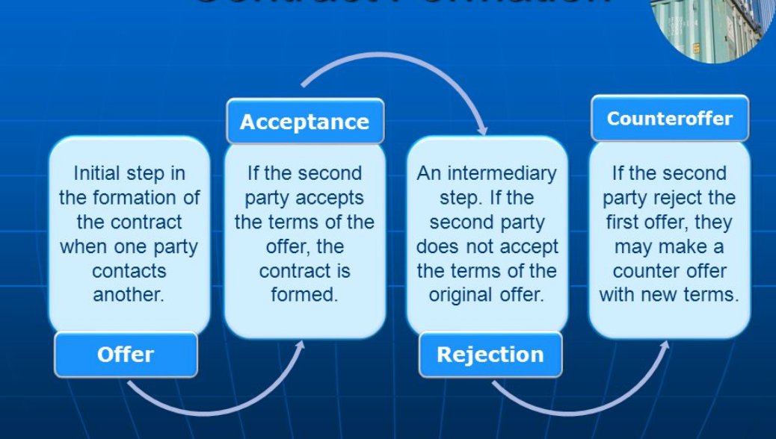
Negotiation

Slide 10
The OFFER
The person’s intention to propose the conclusion of a certain contract under certain determined conditions.
In order to have a valid offer, it needs to:
- fulfil the validity conditions of consent. Which are ?
- to be firm presented, without any reserves and it has to be complete, therefore to contain the minimum fundamental elements to contract
- the offer can be express or implicit

Slide 11
Validity conditions
The assent - Consent of the parties:
- it has to be expressed by a capable person
The person who expresses it needs to have the intention to produce legal effects
It must be externalized
It needs to be genuine (must not be affected by vices)

Slide 12
The acceptance of the offer
- is the person’s clear intention to accept the conclusion of a certain contract under the proposed conditions
It needs to fulfil all the validity conditions of consent
It has to be pure an simple, so that the receiver is able to accept it without doubts
It has to be clear, to express the obvious intentions to accept the offer and conclude the contract
It needs to be delivered on time to the other party
It needs to have the required form
The acceptance can also be express or implicit

Slide 13
CONSENT - SILence
The assent externalizes the party’s intent to conclude a juridical act.
For being the basis of a valid act, the assent has to fulfill several conditions, as follows:
1) It has to exist. Any act concluded in the absence of the assent will be declared null and void;
2) It has to be unambiguously externalized. It means to result from the words of the parties, either orally or written expressed, or even derived from their actions.
The consent can be expressed verbally, in writing or through a behavior that, according to the law, the convention of the parties, the practices established between them or the customs, leaves no doubt on the intention to produce the corresponding legal effects (art. 1240 Civil Code).

Slide 14
Does silence have any juridical value?
Rule: Generally speaking, the assent cannot be implied, and in case of silence it is considered that it is no assent. Mere inaction and silence are usually not regarded as manifestations of intention to agree over a contract.
Exceptions: the rent contract is considered restored in force if, after the term of the contract has been fulfilled, the parties silently continue to perform it., heir conducts himself like an acceptant of an inheritance, law considers that he has performed a tacit acceptance
In connection with the externalization of consent, the question of the legal value of silence also arises, namely whether the adagio qui tacit consentire videtur is applicable in civil law. In principle, the answer is no, so silence is not worth outside consent.
By way of exception, silence is valid in the following cases:
- when the law expressly provides for this (for example, art. 1810 Civil Code);
- whether, by the express will of the parties, a certain legal significance is attributed to the silence (for example, in the case of determining the manner of renewal or denunciation of a convention);
- when the silence has the value of consent according to the custom.

Slide 15
The Counter offer
According to art. 1197 para. 1 The new Civil Code, the recipient's response does not constitute acceptance when: it contains amendments or completions, does not comply with the form specifically requested by the bidder or reaches the bidder after the bid has expired.
in the above case, “the recipient's response may, however, be considered, depending on the circumstances, as a counter-offer” (art. 1197 paragraph 2 of the New Civil Code).
Late acceptance takes effect only if the author of the offer immediately notifies the acceptor of the conclusion of the contract.
The acceptance made in time, but reached the bidder after the expiration of the term, for reasons not imputable to the acceptor, produces effects if the bidder does not notify him immediately (art. 1198 paragraph 2 of the New Civil Code).
The communication of acceptance must be made by means at least as fast as those used by the bidder, if by law, by agreement of the parties, by established practices between them or from other such circumstances the opposite does not result (art. 1200 paragraph 2 of the New Civil Code).
The offer or acceptance may be withdrawn, if the withdrawal reaches the recipient before or at the same time as the offer or, as the case may be, with the acceptance.

Slide 16
Importance of Moment and place
The determination of the moment of concluding the contract is of practical interest for the following reasons:
a) from the moment of concluding the contract, the principle of its binding force operates and the offer cannot be revoked; also, the acceptance cannot be withdrawn or revoked;
b) the capacity of the parties to contract is assessed depending on the moment of concluding the contract; In general, all elements of the validity of the contract are assessed according to this moment (consent, object and cause, in addition to capacity, in which case, the moment of conclusion is of immediate relevance); consequently, by reporting at this time, the causes of nullity of the contract can be ascertained;
c) in case of conflict of laws in time, the moment of concluding the contract is sometimes the criterion according to which the applicable civil law or the applicable conflict norm in private international law will be established;
d) the moment of concluding the contract constitutes the moment from which certain legal and conventional terms start to run, such as: the term of extinctive prescription and the suspensive or extinctive term of execution of the contract;
e) in the transfer contracts having as object movable goods, the moment of concluding the contract marks the transfer of the property right or of other real rights;

Slide 17
The moment and place of concluding the contracts
A. the conclusion of the contract between present parties
The place of the conclusion of the contract is the place where the negotiations have been carried out and the agreement of the parties has been reached.
B. the conclusion of the contract between absent parties.
- persons who are in different geographical locations, the moment of the conclusion of the contract is more difficult
1. contracts concluded by phone
Concerning the contracts concluded by phone, the moment of concluding the contract is the moment when the parties speak over the phone and their agreement is reached.
Place? Two theories:
a. in Anglo-Saxon systems of law, it is the place of headquarters of the party who receives the call.
b. in continental systems of law, it is the place of headquarters of the party who makes the call.

Slide 18
Absent parties – Mail and other electronic ways
a. the sending (forwarding) theory, that is used mainly in the Anglo-Saxon systems of law.
According to this theory, the contract is concluded at the date when the party who accepts the offer sends the letter of acceptance to the other party.
b. the receiving theory, that is used in more recent legislations (Romanian Civil Code )
According to this theory, the contract is concluded when the party who made the offer receives the letter of acceptance of the other party.
c. the information theory
In accordance to this theory, the contract is concluded when the party who has made the offer is informed by any means of the other party’s acceptance.
The place of the conclusion is the place where the offeror received the acceptance.

Slide 19
REVOCATION AND WITHDRAW OF THE OFFER
Withdraw of the offer, addressed to a present or absent person, can be launched freely any time till the offer gets to the accepter.
(art. 1199 New Romanian Civil Code)
Revocation is related to the existence of a term or not.
If we do not have a term, we may speak about a revocation if it gets to the offered person before the acceptance

Slide 20
The law provides that in case of an offer which has a clear term for acceptance, once it got to the receiver, it may not be revocated for that indicated term, the offeror having to keep it for the time he assumed in the offer.
The circumstance in which we deal with a revocation of an offer that does not have a clear indicated term of acceptance
- the offer addressed to a present person will be ineffective if it is not immediately accepted
-the offer addressed to an absent party must be kept within a reasonable time, given the circumstances, for the recipient to receive, analyze and send the acceptance

Slide 21
NEGOTIATION
- it may be formal or informal
- it is characterized by many preparatory acts
Is governed by the principle of freedom of negotiation
It is sufficient for the parties to agree on the essential elements of the contract
The parties have the freedom to initiate, conduct and break negotiations and cannot be responsible for their failure
They have to negotiate in good faith

Slide 22
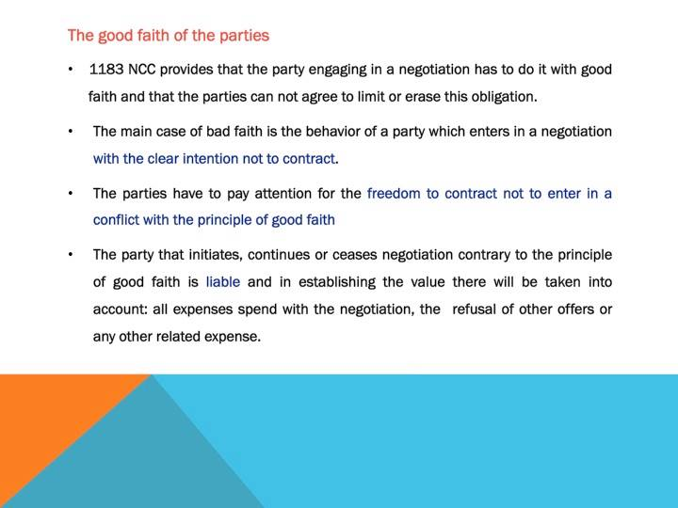

Slide 23
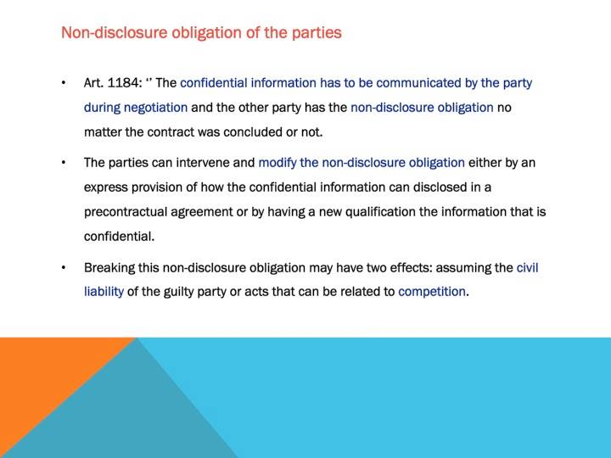

Slide 24
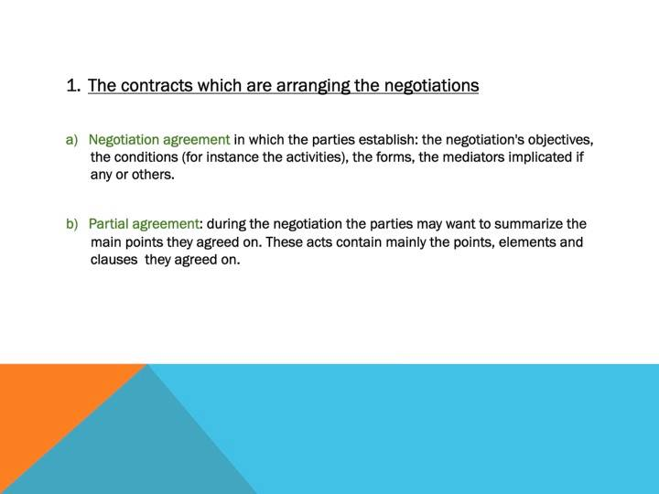

Slide 25
The effects of the contract between the parties
Pacta sunt servanda - the valid contract concluded between the parties has the force of law.
The principle of irrevocability of the act - one of the parties may not revoke or amend the contract unilaterally. There are exceptions to this rule regulated by the legislator (eg revocation of the donation between spouses which can only take place during marriage, in case of termination of the contract concluded for an indefinite period, it will end by notification, the testament that can be revoked ...)
There are three institutions in Romanian law that can remove or modify the effects of the contract:
Major force
The fortuitous case
Unpredictability

Slide 26
The effects of the contract towards third parties
The principle of relativity of the legal act - the effects of the contract will occur between the party who concluded the contract. Through contractual parties we need to understand the natural and legal person who directly and personally or through a representative, expressed their consent for the conclusion of the contract.
Opposability to third parties - which may not affect the rights and obligations arising from the contract. Third parties may avail themselves of the effects of the contract, but without having the right to demand its execution, except in cases provided by law.
Exceptions: representation, stipulation for another ...

Slide 27
INTERNATIONAL SALE
Transactions with an international (foreign) or cross border element are transactions that fall under the regulation of the international private law branch. In almost all cases, these transactions are based on a contract.
Subjective criteria
Objective criteria
International organizations who play a role
in regulating international sales: UN, UNIDROIT, EU.

Slide 28
UN Convention on Contracts for the International Sale of Goods (CISG)
Concluded in Vienna in 1980
CISG has a residual application
explicitly or implicitly to derogate
derogation can be total or partial

Slide 29
CISG
In order to be able to apply the CISG to a contract of sale, any court of law that has jurisdiction has to check whether the requirements of Art. 1, 1CISG have been met.
According to Art. 1, this treaty is about contracts concerning the sale of goods (so not ‘services’), which are international contracts closed between undertakings (‘places of business are in different States’) and the CISG can be used only:
a when the States (of the contracting parties) are Contracting States; or
b when the rules of international private law lead to the application of the law of a Contracting State.

Slide 30
The Convention only applies as far as the formation of the contract and the parties obligations
The parties can derogate from the Convention

Slide 31
The international sale agreements mustn't be concluded in writing either for their validity nor in order for them to be proven. One can prove a contract with any means they see fit, even with witnesses.
At the moment of ratification/acceptance/approval/accession, the participating states can impose a specific rule for the form of the contract – in this case, the parties must respect it.

Slide 32
Case LAw
Starweiner AG, from Bitburg (Germany), supplies 1,000 bottles of beer to Groenen B.V., a Dutch company established in Groningen. However, the Dutch buyer does not pay in time. The German seller wants to nullify the contract. Should a lawsuit between the German seller and the Dutch buyer arise, would the competent court of law use the CISG to answer this question?

Slide 33
FORMATION OF THE CONTRACT - CSIG
A proposal for concluding a contract addressed to one or more specific persons constitutes an offer if it is sufficiently definite and indicates the intention of the offeror to be bound in case of acceptance. A proposal is sufficiently definite if it indicates the goods and expressly or implicitly fixes or makes provision for determining the quantity and the price.
A proposal other than one addressed to one or more specific persons is to be considered merely as an invitation to make offers, unless the contrary is clearly indicated by the person making the proposal.

Slide 34
FORMATION OF THE CONTRACT - CSIG
An offer becomes effective when it reaches the offeree.
An offer, even if it is irrevocable, may be withdrawn if the withdrawal reaches the offeree before or at the same time as the offer.
Until a contract is concluded an offer may be revoked if the revocation reaches the offeree before he has dispatched an acceptance.
However, an offer cannot be revoked:
(a) if it indicates, whether by stating a fixed time for acceptance or otherwise, that it is irrevocable; or
(b) if it was reasonable for the offeree to rely on the offer as being irrevocable and the offeree has acted in reliance on the offer.
An offer, even if it is irrevocable, is terminated when a rejection reaches the offeror.

Slide 35
Q
What is acceptance?
Can there be additions, limitations and other modifications of the offer?
How can we define period of time for acceptance?
What does late acceptance mean?
Moment of conclusion of contract
A contract is concluded at the moment when an acceptance of an offer becomes effective in accordance with the provisions of this Convention.

Slide 36
Obligations of the Seller
The seller has the following obligations in a contract for international sale of goods:
To hand over the goods and documents that are accompanying the goods
To give goods in conformity with the contract (as pertaining to their quantity, quality and type)
Deliver goods free from any right or third party claim

Slide 37
Obligations of the buyer
The buyer has the following main obligations
To pay the price
The price must exist, be serious, determined or determinable
The place and date of payment will be determined by the parties in the contract, if not it will be paid at the headquarters of the seller at the moment when the goods are placed at the disposal of the parties.
To take delivery of the goods – including all necessary acts that will allow the seller to make delivery.
Conservation may fall upon any of the parties in the contract

Slide 38
Passing of the risk under the International Sale of Goods Convention
Risk = not defined by the Convention, the event that is not determined by a breach of the seller (culpa) and has an unpredictable and eventually insurmountable character.
! The passing of the risk is not equivalent to transfer of property that will be established by the parties through contract
The sale agreement supposes the passing of goods – the seller will deliver the goods to the assigned transporter
The goods are sold during transport – rule: the risk is transferred at the moment when the contract is signed and the goods are identified. There is one exception, when the risk is passed retroactively.
Passing of the risks in other cases – either when the buyer takes over the goods or, in other cases, when the seller hands over the goods.

Slide 39
Termination of the contract
The contract terminates,
according to the law,
by execution,
the agreement of the parties,
unilateral termination,
expiration of the term,
fulfillment or, as the case may be, non-fulfillment of the condition,
fortuitous impossibility of execution,
as well as for any other reasons provided by law.

Slide 40
Specific effects of synallagmatic contracts
The rule of simultaneous execution - mutual obligation of the parties must be executed simultaneously. Exceptions to this rule are those contracts which by their nature or due to the will of the parties are performed differently.
Exception of non-performance of the contract - any contracting party has the right to refuse to perform its own obligation, as long as the other party claiming performance does not perform its obligations under the same contract.
Termination of the contract - if one of the parties does not fulfill its contractual obligations, the other party has the right to unilaterally invoke or sue the termination of the contract.
Risk theory - if an event independent of its will prevents one party from performing its obligations, the contract terminates, the other party being released from its obligations.

Slide 41
Nullity of legal acts
The nullity of the legal act is a civil law sanction that intervenes when the substantive or formal conditions of concluding the act are not observed. Nullity consists in depriving the legal act of the effects that contradict the legal norms enacted for the valid conclusion of the legal act, so it does not always concern the legal act as a whole.
There are two types of nullities:
Absolute nullity:
it can be invoked by any party that has an interest, by court ex officio, or by any other person who has this legal capacity (eg Prosecutor).
Absolute nullity is not time-barred, ie it can be invoked at any time, directly or exceptionally.
Absolute nullity cannot be resolved by confirmation.
Relative nullity:
it can be invoked in principle only by the person whose interest has been harmed by non-compliance with the legal norm.
The relative nullity is prescriptive when invoked by way of action, but imprescriptible when invoked by way of exception.
Relative nullity may be covered by express or tacit confirmation of the injured party.

